Slide 1
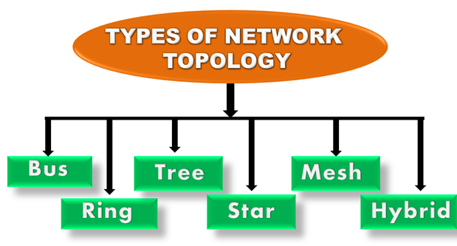
NETWORK TOPOLOGIES:
Topology defines the structure of the network of how all the components are interconnected to each other.

Slide 2
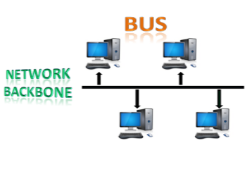
1. BUS TOPOLOGY
The bus topology is designed in such a way that all the stations are connected through a single cable known as a backbone cable.
When a node wants to send a message over the network, it puts a message over the network. All the stations available in the network will receive the message whether it has been addressed or not.

Slide 3
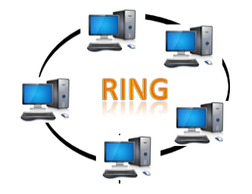
2.RING TOPOLOGY
Ring topology is like a bus topology, but with connected ends.
The node that receives the message from the previous computer will retransmit to the next node.
The data flows in one direction, i.e., it is unidirectional.
The data flows in a single loop continuously known as an endless loop.
It has no terminated ends, i.e., each node is connected to other node and having no termination point.
The data in a ring topology flow in a clockwise direction.

Slide 4
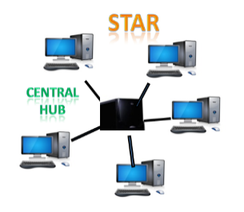
3.STAR TOPOLOGY:
Star topology is an arrangement of the network in which every node is connected to the central hub, switch or a central computer.
The central computer is known as a server, and the peripheral devices attached to the server are known as clients.
Hubs or Switches are mainly used as connection devices in a physical star topology.
Star topology is the most popular topology in network implementation.

Slide 5
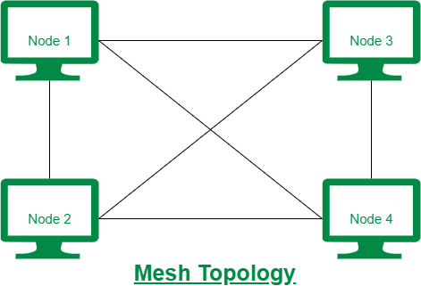
4.MESH TOPOLOGY
Mesh technology is an arrangement of the network in which computers are interconnected with each other through various redundant connections.
There are multiple paths from one computer to another computer.
It does not contain the switch, hub or any central computer which acts as a central point of communication.
Mesh topology can be formed by using the formula: Number of cables = (n*(n-1))/2;

Slide 6
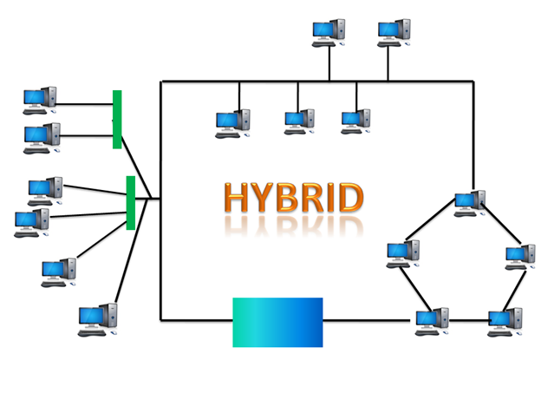
5.HYBRID TOPOLOGY
The combination of various different topologies is known as Hybrid topology.
A Hybrid topology is a connection between different links and nodes to transfer the data.
When two or more different topologies are combined together is termed as Hybrid topology and if similar topologies are connected with each other will not result in Hybrid topology. For example, if there exist a ring topology in one branch of ICICI bank and bus topology in another branch of ICICI bank, connecting these two topologies will result in Hybrid topology.

Slide 7
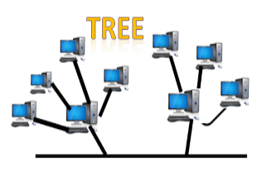
6.TREE TOPOLOGY
Tree topology combines the characteristics of bus topology and star topology.
A tree topology is a type of structure in which all the computers are connected with each other in hierarchical fashion.
The top-most node in tree topology is known as a root node, and all other nodes are the descendants of the root node.
There is only one path exists between two nodes for the data transmission. Thus, it forms a parent-child hierarchy.

Slide 8
DMZ(demilitarized Zone)
A DMZ Network is a perimeter network that protects and adds an extra layer of security to an organization’s internal local-area network from untrusted traffic. A common DMZ is a subnetwork that sits between the public internet and private networks.
The end goal of a DMZ is to allow an organization to access untrusted networks, such as the internet, while ensuring its private network or LAN remains secure.

Slide 9
How does a DMZ work?
. The DMZ network serves as a buffer between the internet and the private network of an organization. It is isolated by a security gateway like a firewall that filters traffic between the DMZ and LAN. The default DMZ server is secured by another gateway that filters the incoming traffic from external networks. It is ideally located between two firewalls.
The DMZ firewall setup makes sure that the incoming network packets are observed by a firewall or other security tools before they reach the servers hosted in the DMZ. So, even if an attacker somehow gets past the first firewall, they will have to have access to the hardened services in the DMZ to cause any kind of serious damage to a business.
If the external firewall is penetrated by an attacker and a system in the DMZ is compromised, they will also have to get pass an internal firewall before even gaining access to all the sensitive corporate data. A highly skilled attacker may sometimes be able to breach a secure DMZ, but various alarm systems and resources are there to provide plenty of warning about the breach in progress.

Slide 10
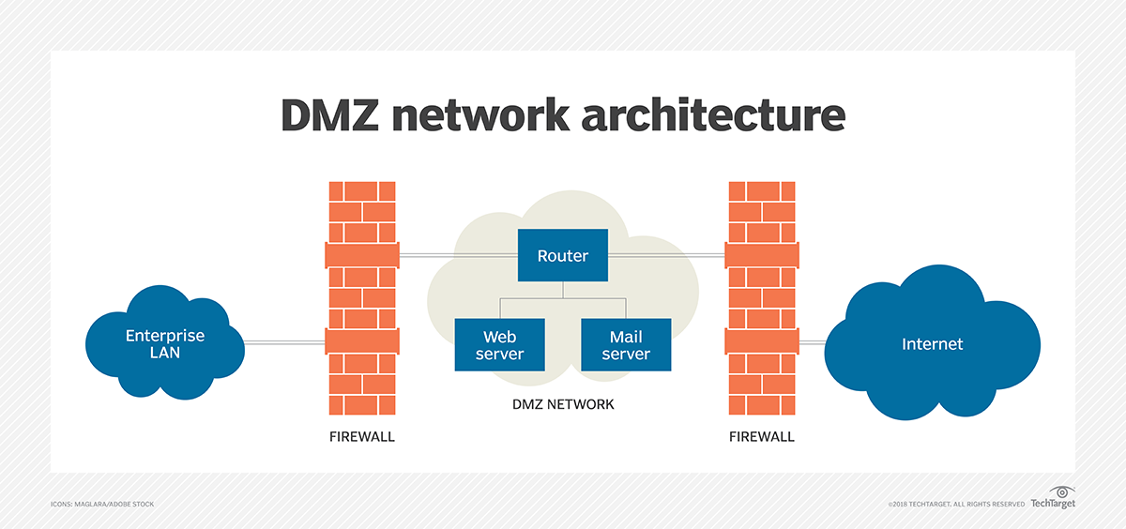

Slide 11
Examples of DMZs
Cloud services: Some cloud services, such as Microsoft Azure, use a hybrid security approach in which a DMZ is implemented between an organization's on-premises network and the virtual network. This method is typically used in situations where the organization's application run partly on premises and partly on the virtual network.
Home networks. A DMZ can also be useful in a home network in which computers and other devices are connected to the internet using a broadband router and configured into a LAN. Some home routers include a DMZ host feature. The DMZ host feature designates one device on the home network to function outside of the firewall, where it acts as the DMZ while the rest of the home network lies inside the firewall.

Slide 12
Security Benefits of DMZ
Allows access control – An increased degree of protection guarantees that only genuine traffic can enter the DMZ, making it extremely difficult for hackers to penetrate internal networks since they would have to pass through two firewalls to get access.
Prevents network reconnaissance – A DMZ network enables a company to access essential internet services securely. It acts as an intermediary, preventing attackers from conducting reconnaissance activity to hunt for potential targets. If a DMZ system is hacked, the internal firewall protects the private network and makes external surveillance difficult. Consequently, compromising a single node in the network does not compromise the whole system.
Protects from internet protocol (IP) spoofing: Attackers may try to gain access to systems by counterfeiting an IP address and imitating a signed-in, approved device. A DMZ may recognize and prevent potential faking attacks while another service verifies the IP address’s validity.

